Slide 1
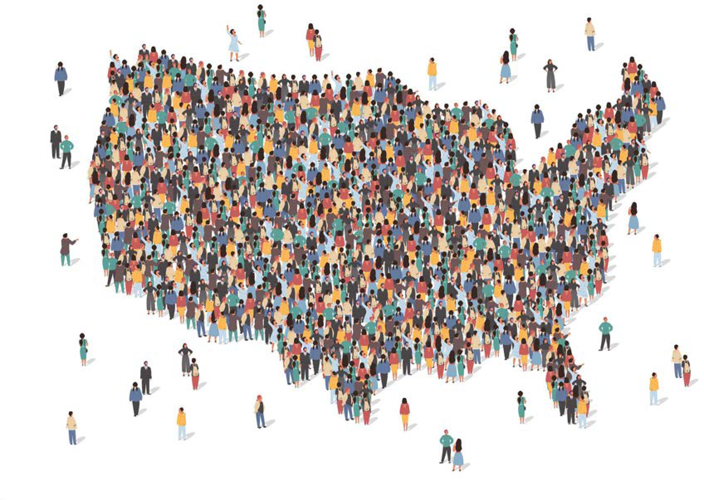


A 21st Century Census Curated Data Enterprise:
Pilot Demonstration on Skilled Nursing Facilities
Presentation to Census Bureau
October 31, 2022
Team: Vicki Lancaster, Dawen Xie, Henning Mortveit, Samarth Swarup, Aaron Schroeder, Sallie Keller, Stephanie Shipp

Slide 2



















Paradigm Shift for Census Bureau: Focus on Purpose and Use
With the accelerating pace of change in our society and economy, we must constantly innovate how we collect and report official statistics to understand who we are, and where we are going.
Equity and Inclusion
Counting Children
Family Units
Rural Communities
Local Businesses
Tribal Areas
Vulnerable Populations
Elderly Residential Care
The Unhoused
Migration
Climate Change
Gig Economy
Workforce Automation
Differential Undercount
Broadband Deployment
Emergency Preparedness
Economic Mobility
Commuting Patterns
Changing Demographics

Slide 3

Introducing the Curated Data Enterprise
“Linking across time, and surveys, supplemented with third-party and administrative data can help improve the coverage and completeness of Census Bureau data, innovating beyond a survey-alone model that has reached its scientific and practical limits.” (Keller et al. 2022)
We describe this new, innovative state as a Curated Data Enterprise (CDE).
CURATED DATA
ENTERPRISE
The Census Bureau of the Future
Both an infrastructure and a continuously evolving ambition to empower and enable Bureau scientists and their data users to develop new measures of people, places, and the economy.
Exploits multiple data sources, from sample surveys, censuses, and other official administrative and third-party data, which can provide more robust, timely, and comprehensive measures when combined.
3

Slide 4
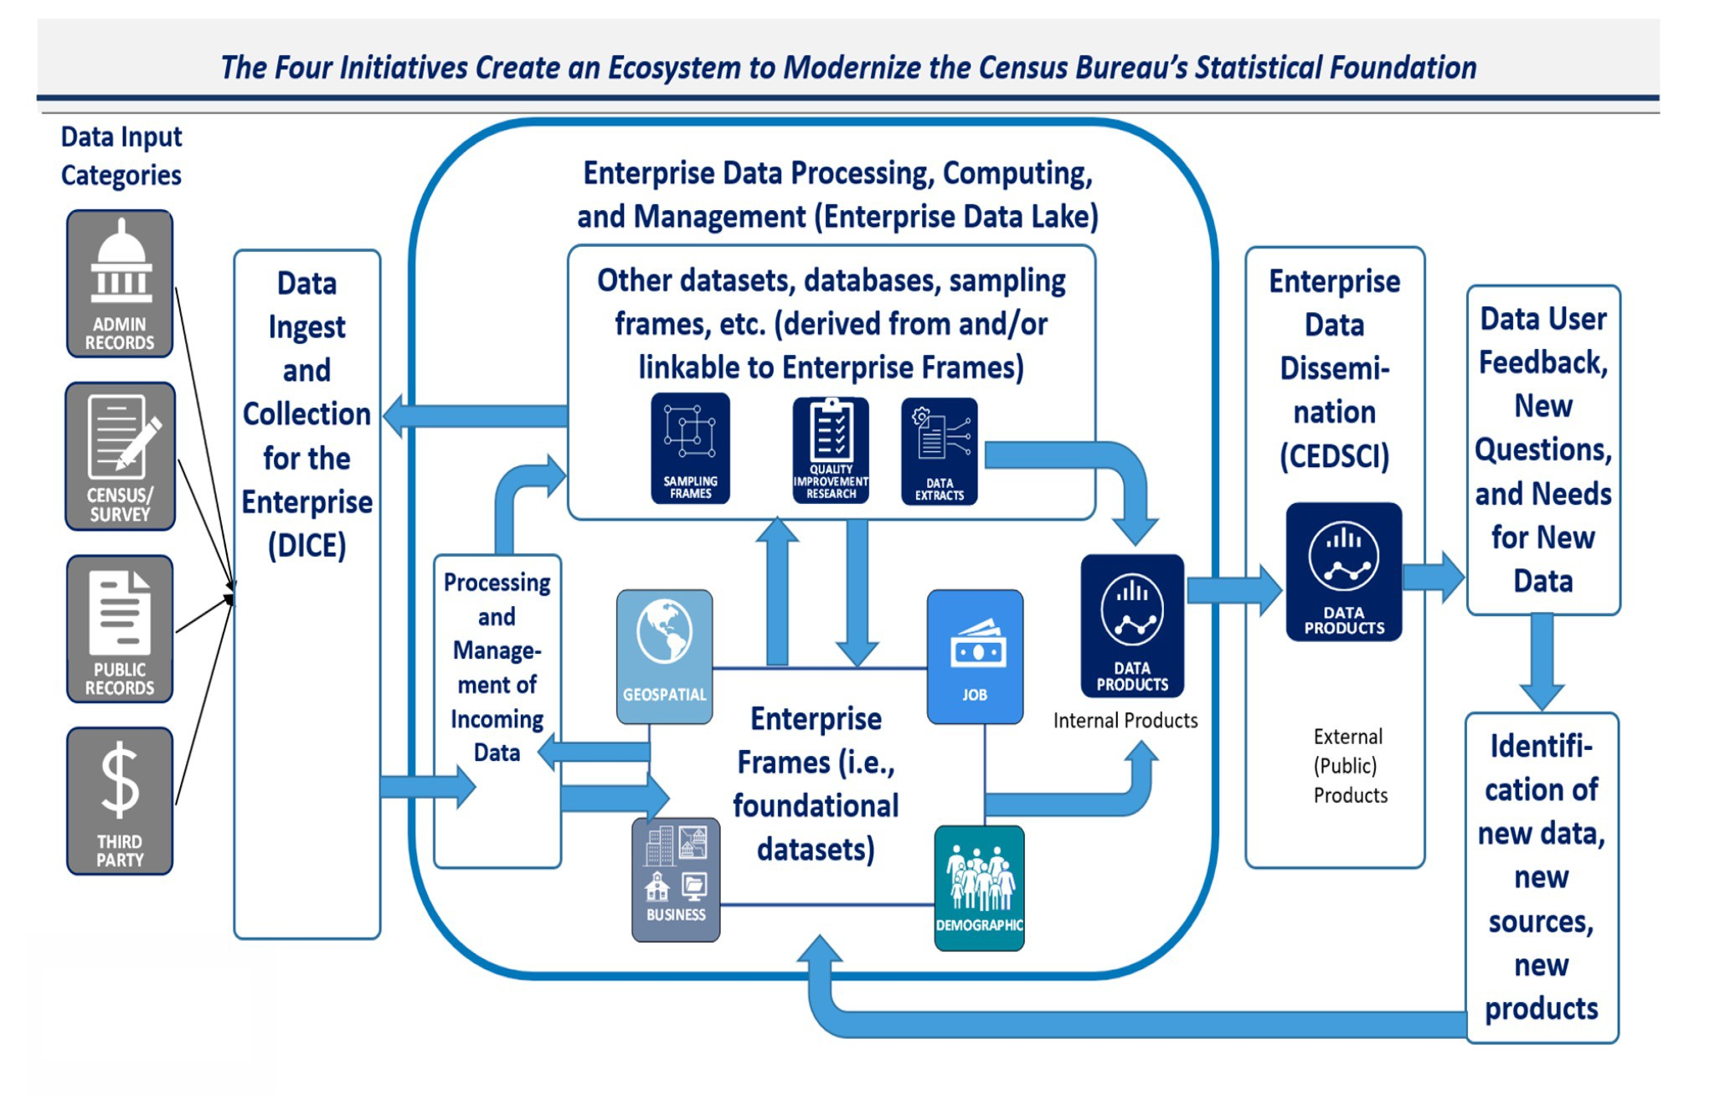

Building a Census Bureau Modern Data-Centric Ecosystem
Change is here!
“Our changing culture and rapid changes in data and technology tell us that censuses and surveys alone, while still critical, can no longer answer society’s questions completely or quickly enough to satisfy the modern appetite for information.”
Michael Thieme, Oct. 5, 2022
4
Source: https://www.census.gov/newsroom/blogs/research-matters/2022/10/technology-transformation.html?utm_medium=email&utm_source=govdelivery

Slide 5
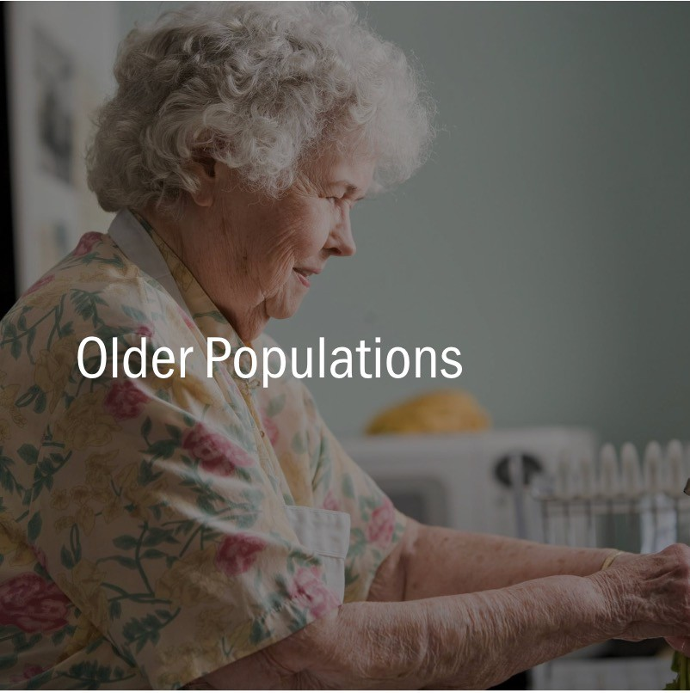

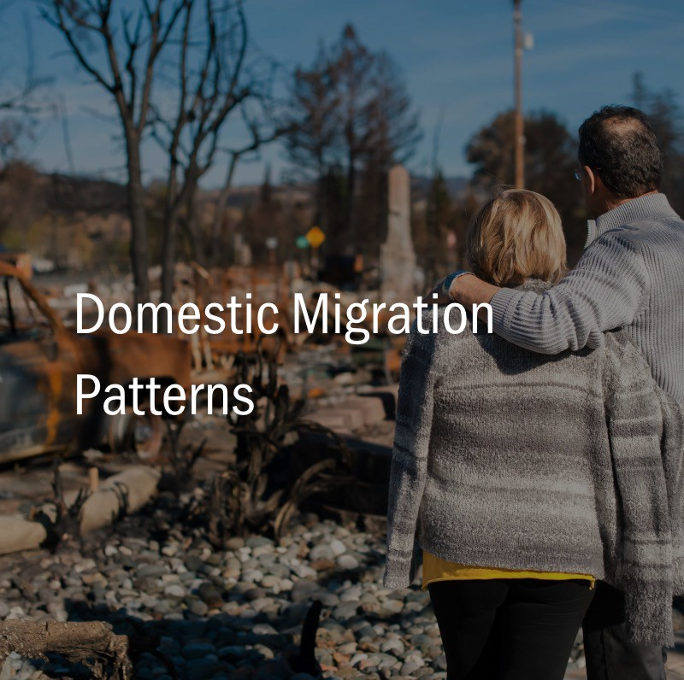
Use Cases - Compelling Examples of “Purpose and Use”
Use Case - a research method to identify, clarify, and organize requirements to create a system or overall system component, such as the Curated Data Enterprise

Slide 6

Use Case–How resilient is a skilled nursing facility...
Climate Resilience
The capacity of an individual, community, or institution to dynamically and effectively respond to shifting climate impact circumstances while continuing to function at an acceptable level.¹
Goal: Quantify Skilled Nursing Facility (SNF) resilience to a severe climate event
Conduct a realistic appraisal of the skilled nursing facility that includes the community in which the SNF resides, the physical facility, and the ability of the nursing staff to get to work and function.
¹U.S. Department of Health and Human Services (Fall, 2014). Guenther, R., & Balbus,
J. Primary Protection: Enhancing Health Care Resilience for a Changing Climate.

Slide 7
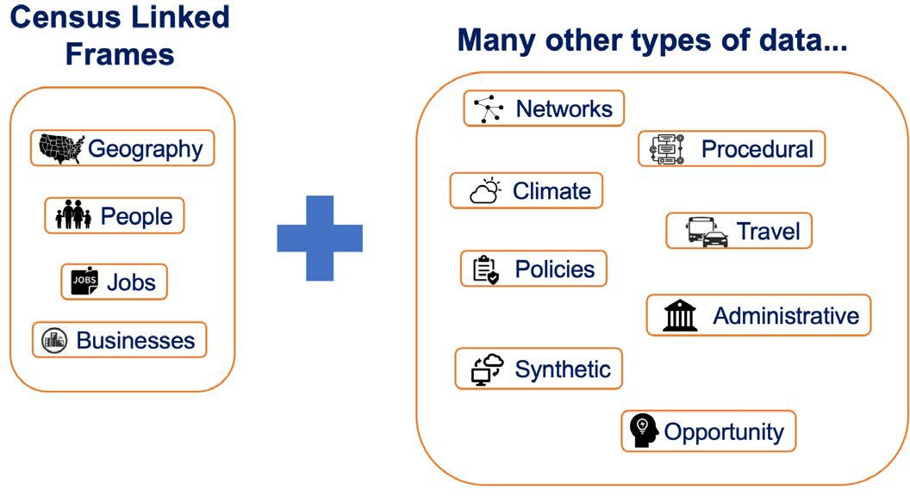

Overview - Curated Data Enterprise Demo
CDE Framework guides the Use Case research
Purpose & Use: Questions & Working Hypotheses
Data Discovery [Inventory • Screening • Acquisition]
Data Ingestion & Governance
Data Wrangling
Profiling • Preparation • Linkage • Exploration
Fitness-for-Purpose
Statistical Analyses & Applications Development
Communication & Dissemination
Equity & Ethics Reviews

Slide 8










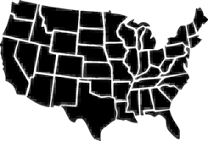








Curated Data Enterprise (CDE) Purpose and Use
CDE Framework guides the Use Case research
Communication & Dissemination
Purpose & Use: Questions & Working Hypotheses
Data Discovery [Inventory • Screening • Acquisition]
Equity & Ethics Reviews
… which selects relevant data and composes into a workflow
Data Ingestion & Governance
Data Wrangling
Profiling • Preparation • Linkage • Exploration
Fitness-for-Purpose
Statistical Analyses & Applications Development
Are
able to
Commute to Work
over the
Road Network
during
Flooding
?
Purpose of use defines a context…
Geography
Jobs
Networks
Travel
Policies
People
Businesses
Climate
Procedures
…

Slide 9

Curated Data Enterprise Components
Communication & Dissemination
Purpose & Use: Questions & Working Hypotheses
Data Discovery [Inventory • Screening • Acquisition]
Data Ingestion & Governance
Data Wrangling
Profiling • Preparation • Linkage • Exploration
Fitness-for-Purpose
Statistical Analyses & Applications Development
Equity & Ethics Reviews
Are
able to
Commute to Work
over the
Road Network
during
Flooding
?
The result forms new data products
Expected number of nursing staff at SNF
Geography Jobs Networks People Businesses Weather
Travel
Policies
Procedures
…

Slide 10



Curated Data Enterprise Process Over Time
…more complex measures can be computed
Communication & Dissemination
Purpose & Use: Questions & Working Hypotheses
Data Discovery [Inventory • Screening • Acquisition]
Data Ingestion & Governance
Equity & Ethics Reviews
Data Wrangling
Profiling • Preparation • Linkage • Exploration
SNF Climate Resilience
Fitness-for-Purpose
Statistical Analyses & Applications Development
As more data products are created…
Nursing Staff at SNF
SNF Deficiencies
SNF Community Support
Geography
Jobs
Networks
Travel
Policies
People
Businesses
Weather
Procedures
…

Slide 11
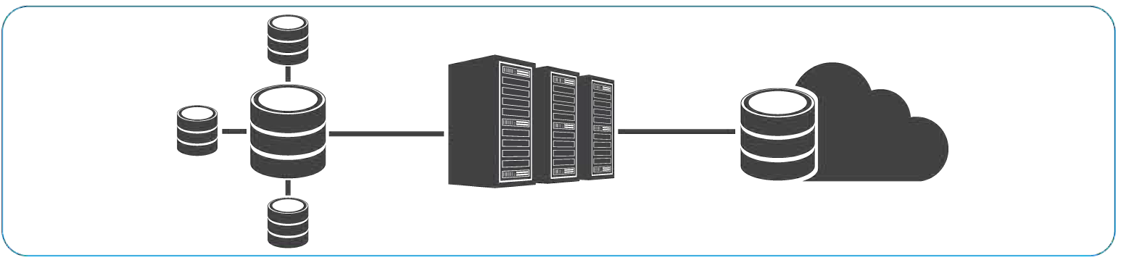
Curated Data Enterprise Process Over Time
Communication & Dissemination
Purpose & Use: Questions & Working Hypotheses
Data Discovery [Inventory • Screening • Acquisition]
Data Ingestion & Governance
Equity & Ethics Reviews
Data Wrangling
Profiling • Preparation • Linkage • Exploration
…facilitated and supported by high-performance computing
Fitness-for-Purpose
Statistical Analyses & Applications Development
E(Nursing Staff at SNF)
SNF Deficiencies
SNF Community Support
Geography
Jobs
Networks
Travel
Policies
People
Businesses
Weather
Procedures
…

Slide 12
Curated Data Enterprise Process Over Time
Communication & Dissemination
Purpose & Use: Questions & Working Hypotheses
Data Discovery [Inventory • Screening • Acquisition]
Equity & Ethics Reviews
The CDE will provide a platform for innovative data use and growth through purpose-driven computational and statistical integration and analysis.
Data Ingestion & Governance
Data Wrangling
Profiling • Preparation • Linkage • Exploration
Fitness-for-Purpose
Statistical Analyses & Applications Development
New data sources
New data products
New analyses
…
E(Nursing Staff at SNF)
SNF Deficiencies
SNF Community Support
Geography
Jobs
Networks
Travel
Policies
People
Businesses
Climate
Procedures
…

Slide 13




Curated Data Enterprise (CDE) Framework - a guide to implementing use case
Purpose & Use: Questions & Working Hypotheses
Data Discovery [Inventory • Screening • Acquisition]
Data Ingestion & Governance
Data Wrangling
Profiling • Preparation • Linkage • Exploration
Fitness-for-Purpose
Statistical Analyses & Applications Development
Communication & Dissemination
Equity & Ethics Reviews

Slide 14

Purpose & Use [Questions & Working Hypotheses]
Can Skilled Nursing Facilities (SNF) workers get to work?
Can communities provide support to SNF during an emergency?
Are SNFs prepared for emergencies?
Skilled Nursing Facility (SNF) definition
A nursing facility with the staff and equipment to give skilled nursing care and/or skilled rehabilitation services and other related health service.
Source: CMS Glossaryx

Slide 15
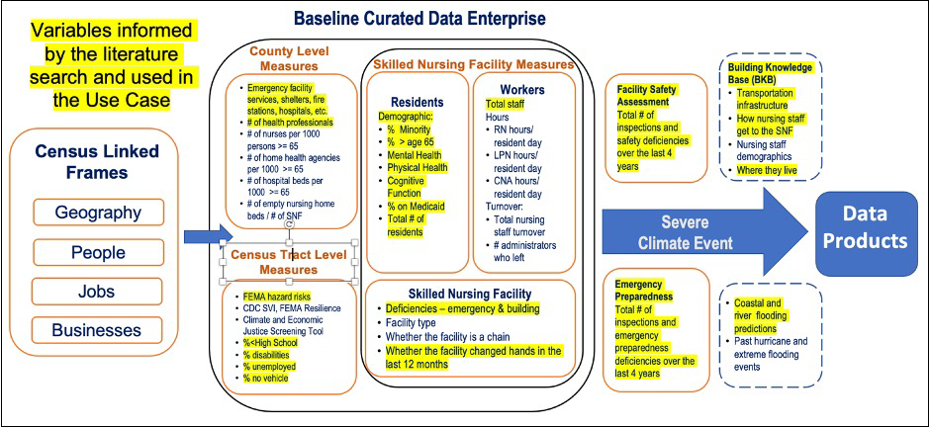
Conceptual Data Map Aligned to Purpose and Use

Slide 16

Data Discovery [Inventory-Screening-Acquisition]
SNF Resilience
Department of Health and Human Services
Centers for Medicare and Medicaid Services (CMS)
Payroll Based Journal
Provider Information
Fire Safety Deficiencies
Inspection Dates
Ownership
Citation Lookup
LTC Focus Data sponsored by NIH
Certification and Survey Provider Enhanced Reporting
Biocomplexity Institute synthetic data
Community Resilience (County/City, Census tract) Department of Commerce
Census American Community Survey Department of Homeland Security
Federal Emergency Management
Administration: National Risk Index for Natural Disasters
Homeland Infrastructure Foundation- Level Data
Department of Health and Human
Services
Health Resources and Services Administration: Area Resource Files

Slide 17
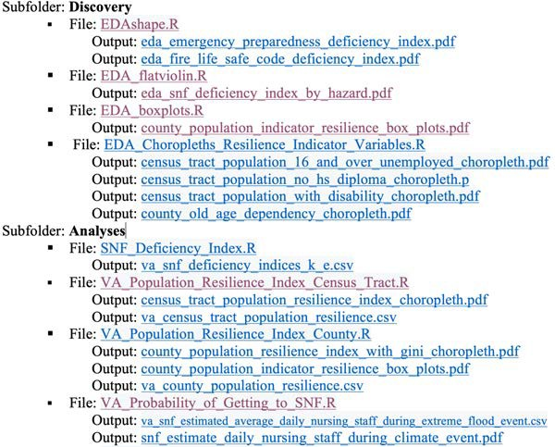
Data Ingestion and Governance - GitHub
Folders, sub-Folders, and sub-sub-Folders
Documents Source Code Data
Discovery Analyses
Literature | Products
Deficiencies | Data Tables**
Emergency Preparedness | Curation Report & Presentations
Nursing Staff Levels
Ownership | Visualizations
Quality | Processes**
Resilience
SNF*** | Community
Facility* | Demographic
Nursing Staff* | Climate Change Risk*
Residents* | Resilience*
Owners*
https://github.com/uva-bi-sdad/census_cde_demo_2/
*Each folder contains a meta data folder with data dictionaries and technical documents.
**Contains additional subfolders.
***SNF is Skilled Nursing Facilities

Slide 18

Data Wrangling and Exploration RQ1: Can SNF workers get to work?
Identifying Flood Risk and SNF Workers’ Transportation Routes at Census Tract Level

Slide 19
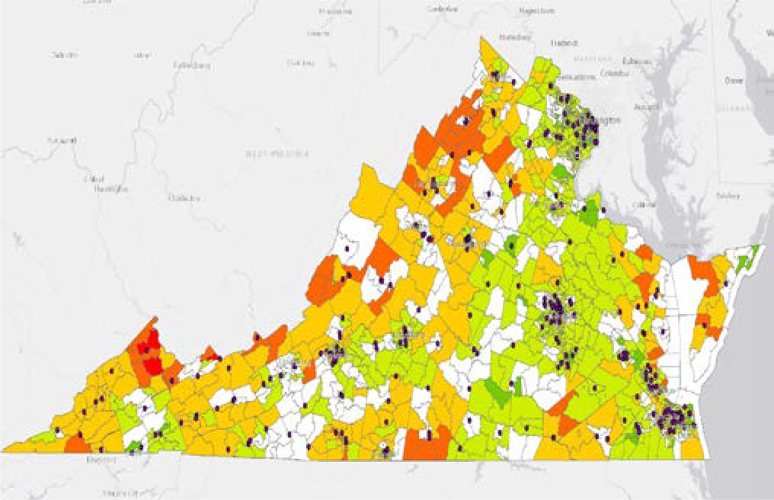
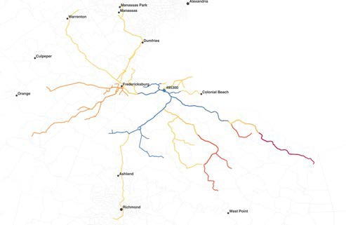
RQ1:Can SNF workers get to work during a flooding event?
Data discovery – flooding risks, nursing home locations, road networks
Compute the likely commuting route for each synthetic worker - Identify workers, home locations, nursing home locations, and routes
Overlay the river and coastal flooding by census tracts
Estimate flooding risk along the transportation routes
For each SNF, there is a flood risk; treat that value as a proxy for the probability of a worker not getting to work
Calculate risk for each SNF worker as the percent or workers that cannot make it to work during a flooding event

Slide 20
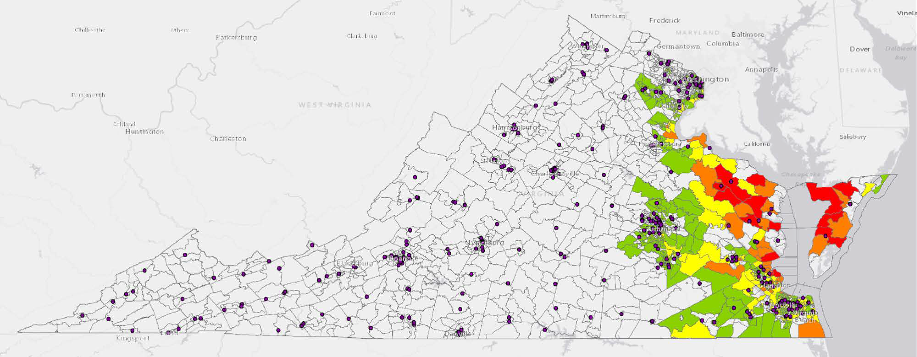
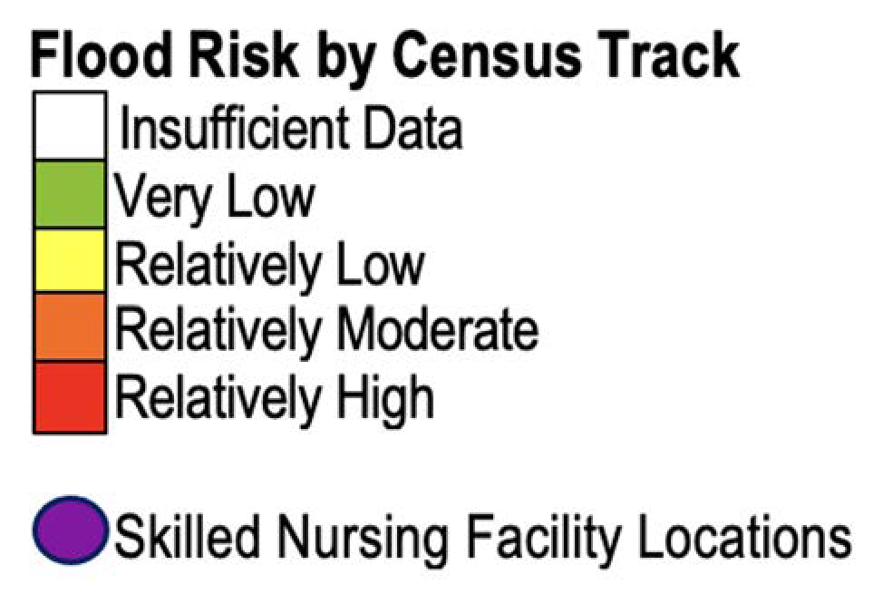
Coastal Flooding Risk in Virginia & SNF Locations
Data Sources: FEMA National Risk Index (Nov 2021) https://hazards.fema.gov/nri/data-resources; Location of Skilled Nursing Homes: LTC Focus Data sponsored by NIH

Slide 21
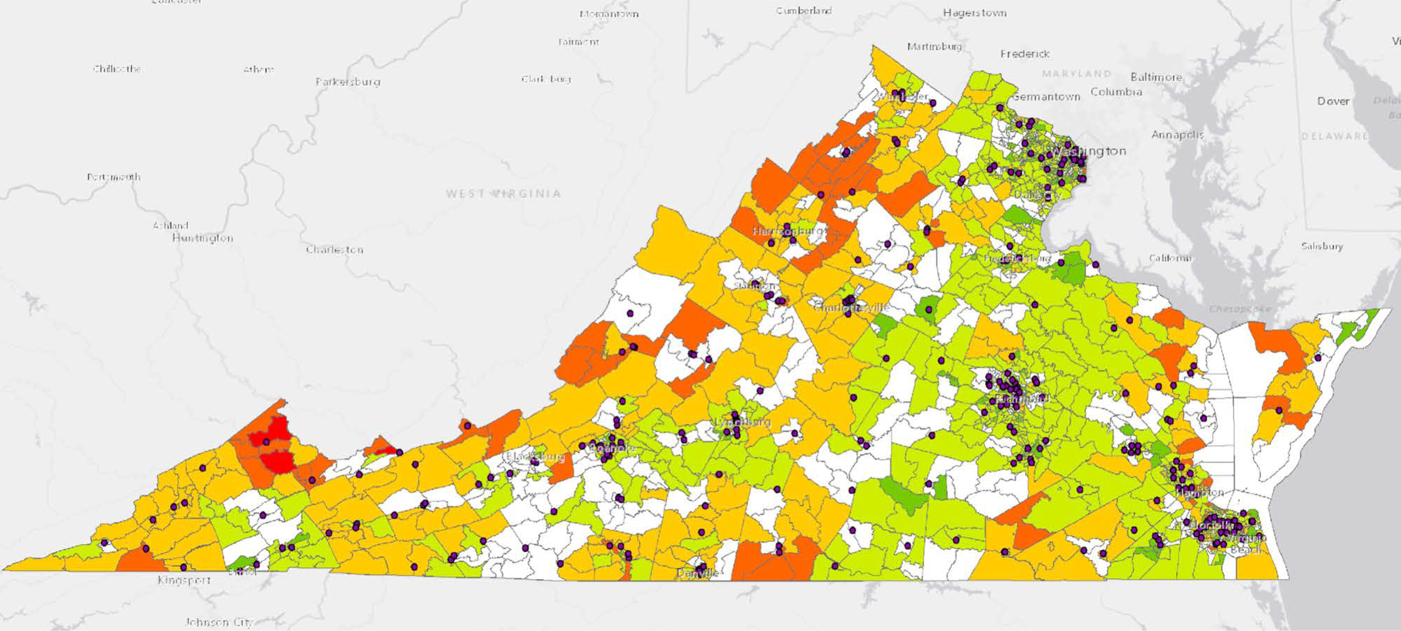
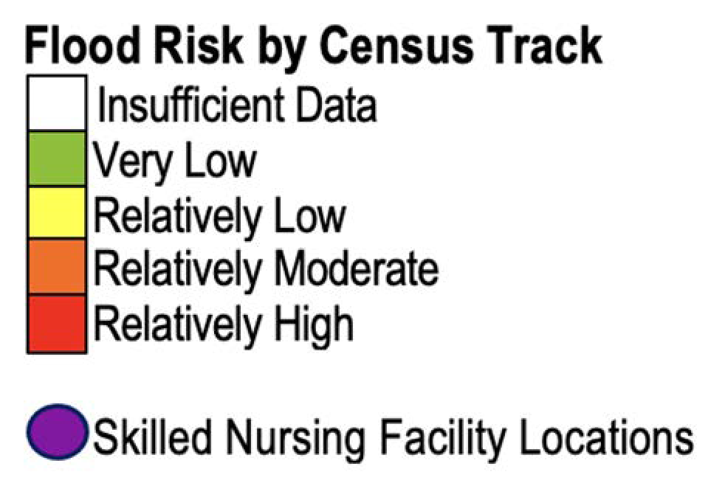
River Flooding Risk in Virginia & SNF Locations
Data Sources: FEMA National Risk Index (Nov 2021) https://hazards.fema.gov/nri/data-resources; Location of Skilled Nursing Homes: LTC Focus Data sponsored by NIH

Slide 22
Risk Scores – Can SNF workers make it to work?
Assumption: Use the combined value of maximum river flood + maximum coast flood risk along worker's transportation route as the worker’s probability of not getting to work during a flooding event
Annual average risk across Virginia: The 283 SNF used in our research have a total average daily nursing staff of 12,609. We estimate that ~10,005 (95% CI: 9,013, 10,700 or 79% will be able to get work.
Percent Loss: The individual SNF nursing staff percentage loss ranges from a high of 52% to a low of 7%, with a median of 19%.
DATA SOURCE: FEMA National Risk Index (Nov 2021) https://hazards.fema.gov/nri/data-resources;

Slide 23
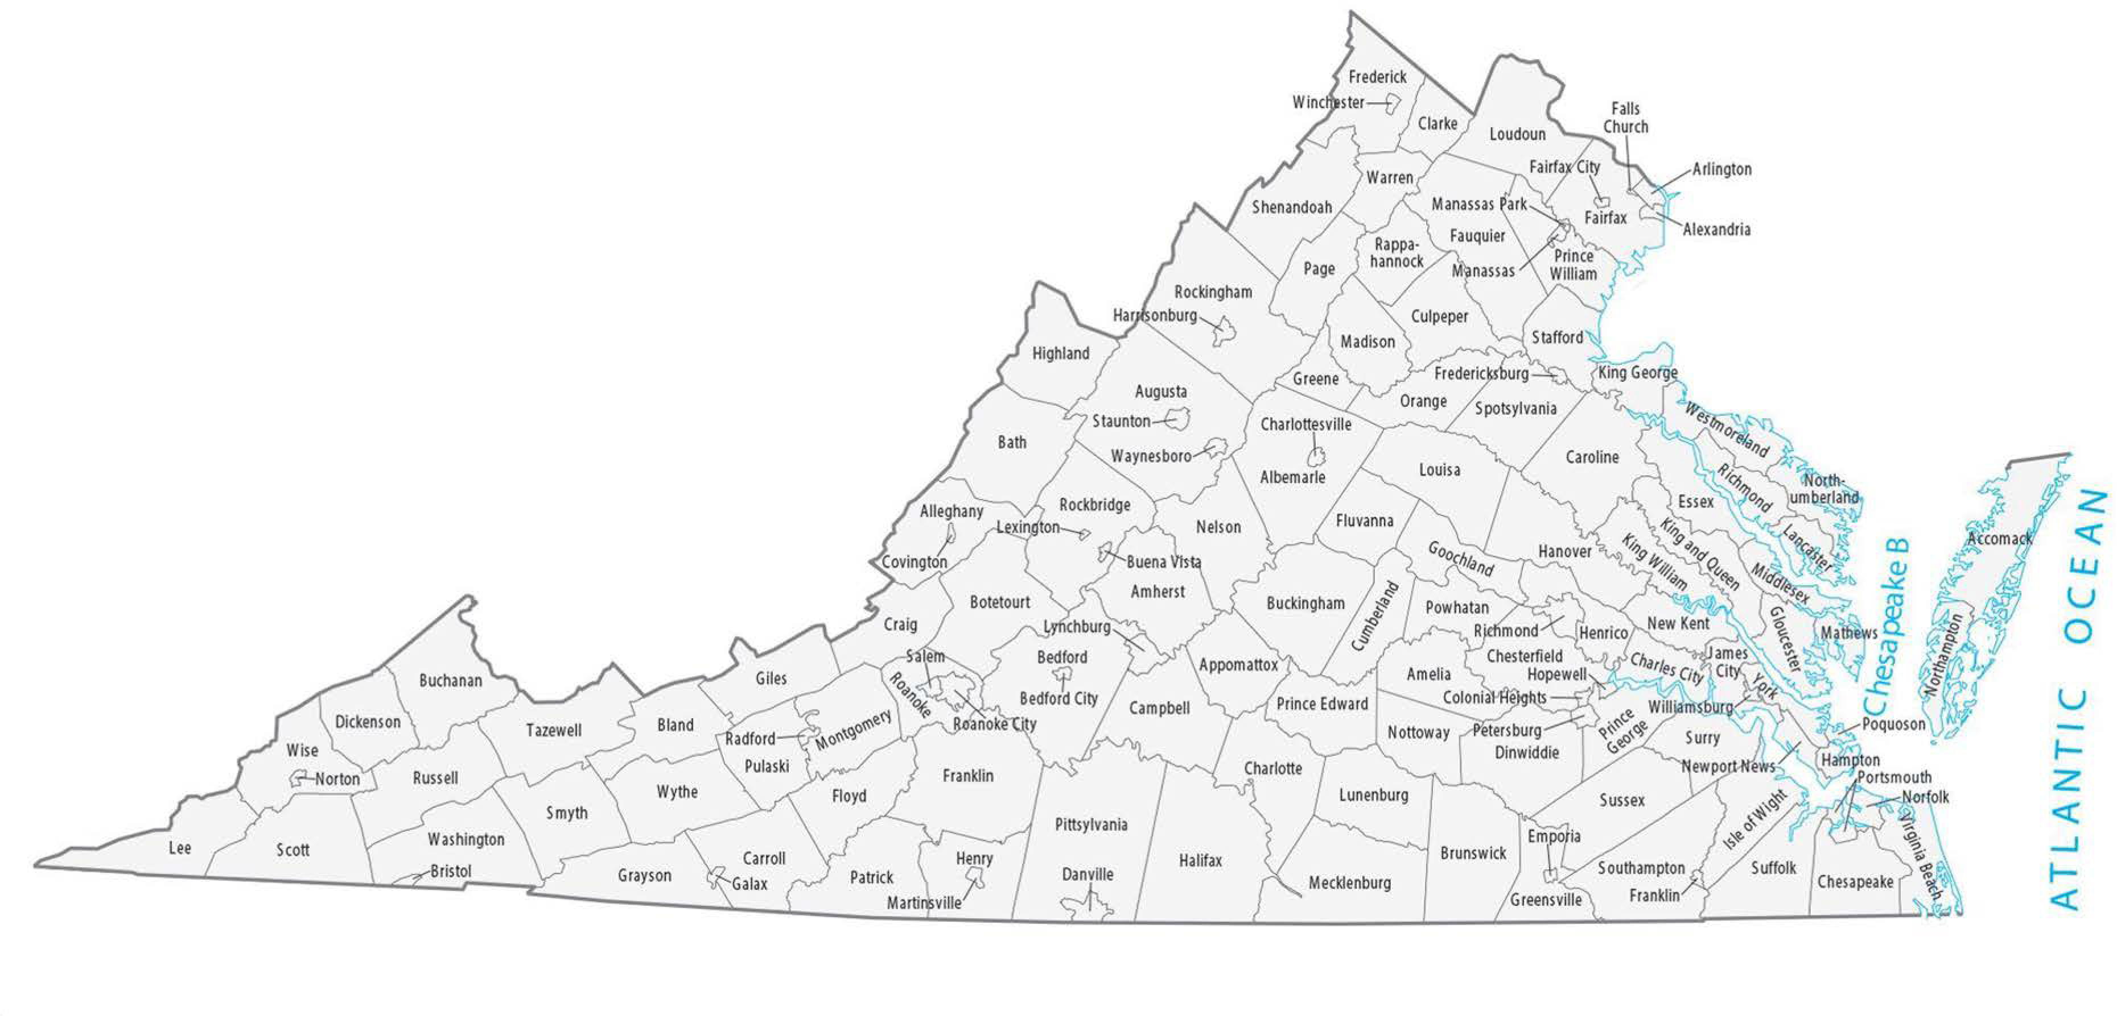
Case Studies – Flood Risk in Virginia
King George, VA, 41 nursing staff employees; mixed risk routes
Warsaw, VA, 35 nursing staff employee; most routes have high risks
Hopewell, VA, 48 nursing staff employees; most routes have low risks
1
1
2
3

Slide 24
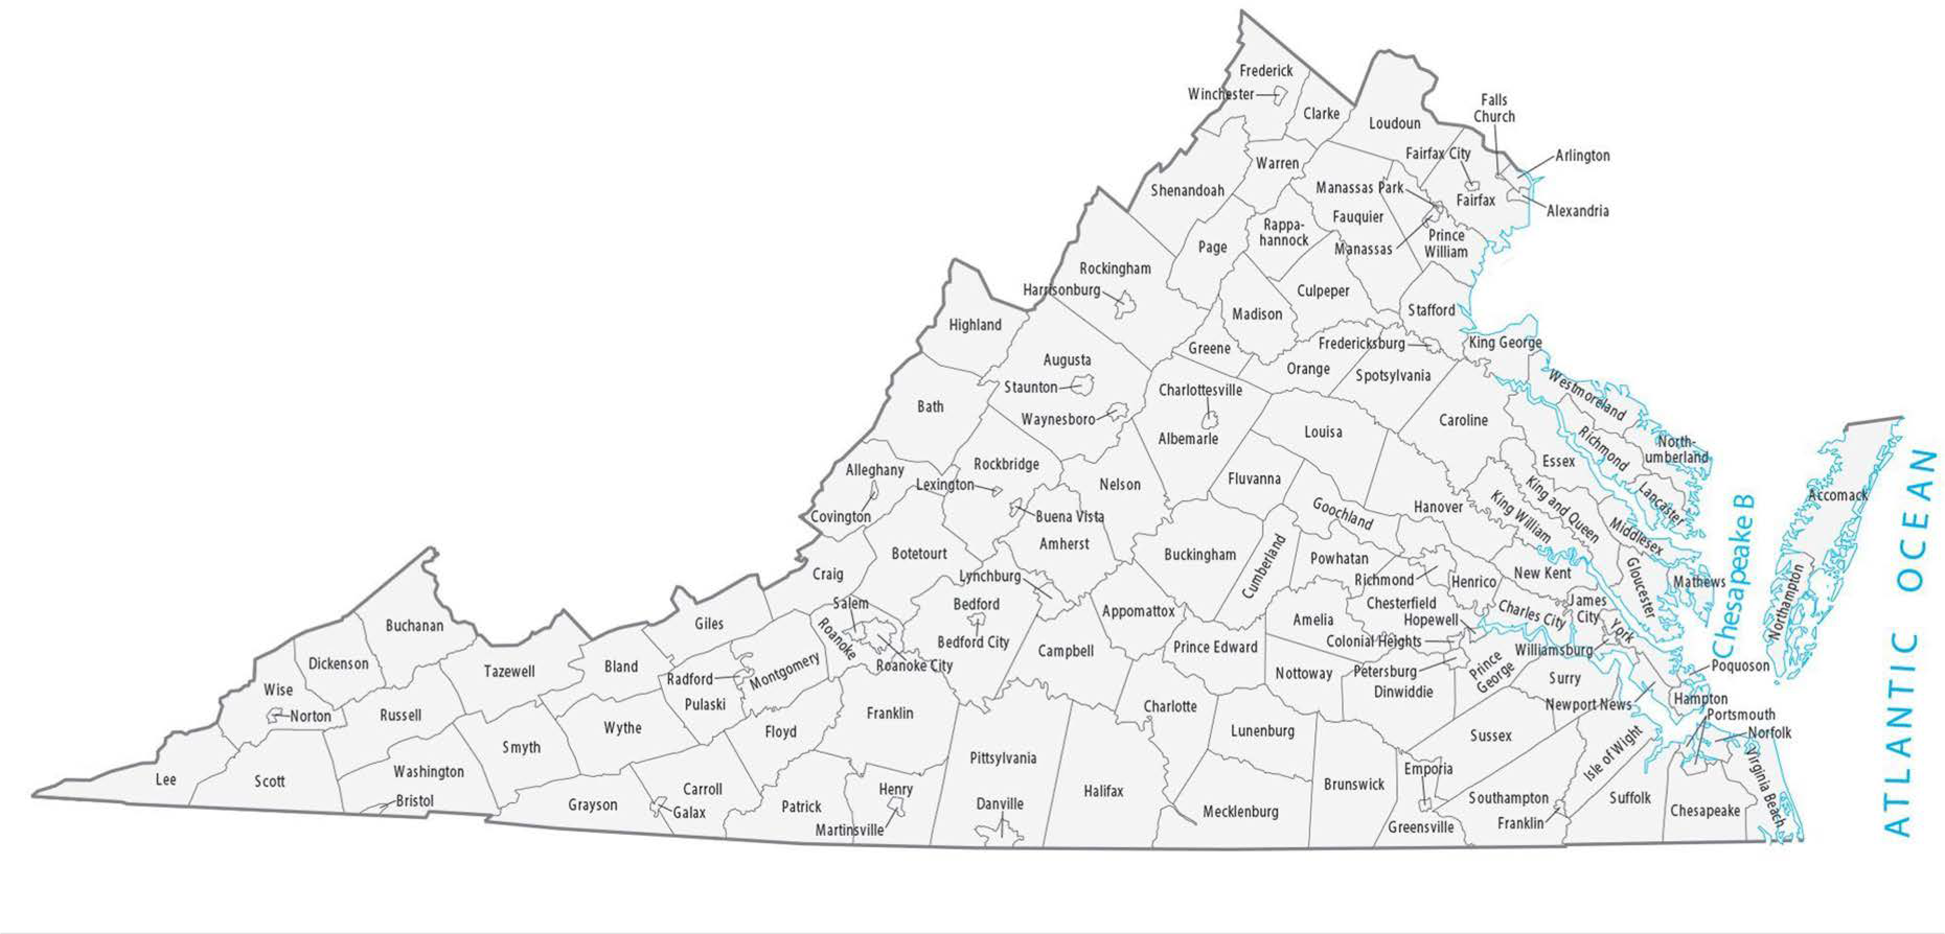
Case Study 1: King George, Virginia
Located near Potomac River and the opening to the Chesapeake Bay
1
1

Slide 25
King George 495300
River flood risk | 3.5
Coastal flood risk | 6.2
Routes avg high risk | 21.7
Population (2020) | 4601
# SNF nursing staff | 41
% SNF nursing loss | 24
Risk- blue (low), yellow, orange, red, dark red (high)

Slide 26

Data Wrangling and Exploration RQ2: Are SNF prepared for emergencies?
Identifying SNF Resilience
Computations
SNF Emergency Preparedness/fire safety deficiency index as a proxy for SNF resilience

Slide 27
Are SNF prepared for emergencies?
CMS Skilled Nursing Home Deficiencies as a proxy for preparedness
Emergency Preparedness (EP) Deficiencies – 4 elements
Emergency plans
Communication plan
Training and testing
Policies and procedures
Life Safety Code (LSC) Deficiencies - Fire protection requirements
Designed to provide a reasonable degree of safety from fire, smoke, and panic
Construction
Protection
Operational features

Slide 28
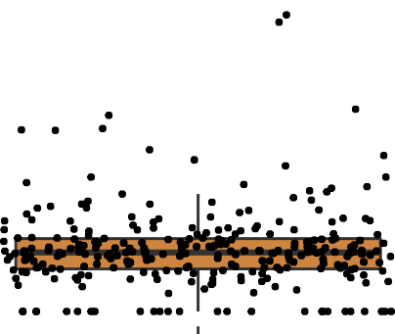
EP Deficiency Index
Histogram
0.015
Probability
0.010
Calculate
Calculate a separate Emergency Preparedness (EP) deficiency index for each Skilled Nursing Facility.
0.005
0.000
Normalize the number deficiencies over the past four years by the number of SNF inspections over the past four year (2018 – 2022).
0
100 200
Observed Values
300
Normalize
Q−Q Plot
300
Average
Average the number of days it took to resolve each deficiency.
Observed Values
200
100
Transform the letter inspection rating for scope and severity to a numerical weight using the CMS technical guide, Care Compare Nursing Home Five-Star Quality Rating System; then we took the average.
Transform
0
−3
−2
−1 0 1
Theoretical Quantile
2
3
Box Plot
Add
Add 1 through 3 to get the deficiency index for EP and LSC.
300
Observed Values
200
DATA SOURCE: The Centers for Medicare & Medicaid Services
100
Fire Safety Deficiencies https://data.cms.gov/provider-data/dataset/ifjz-ge4w
Inspection Dates https://data.cms.gov/provider-data/dataset/svdt-c123
0

Slide 29
Data Wrangling and Exploration
Can the community provide support to SNF during emergency events?
Identifying Community Assets
Computations
Community Resilience Indices
Shelter Facilities and Emergency Services Providers per 10K people
Medical Professional Shortages per 10K people

Slide 30
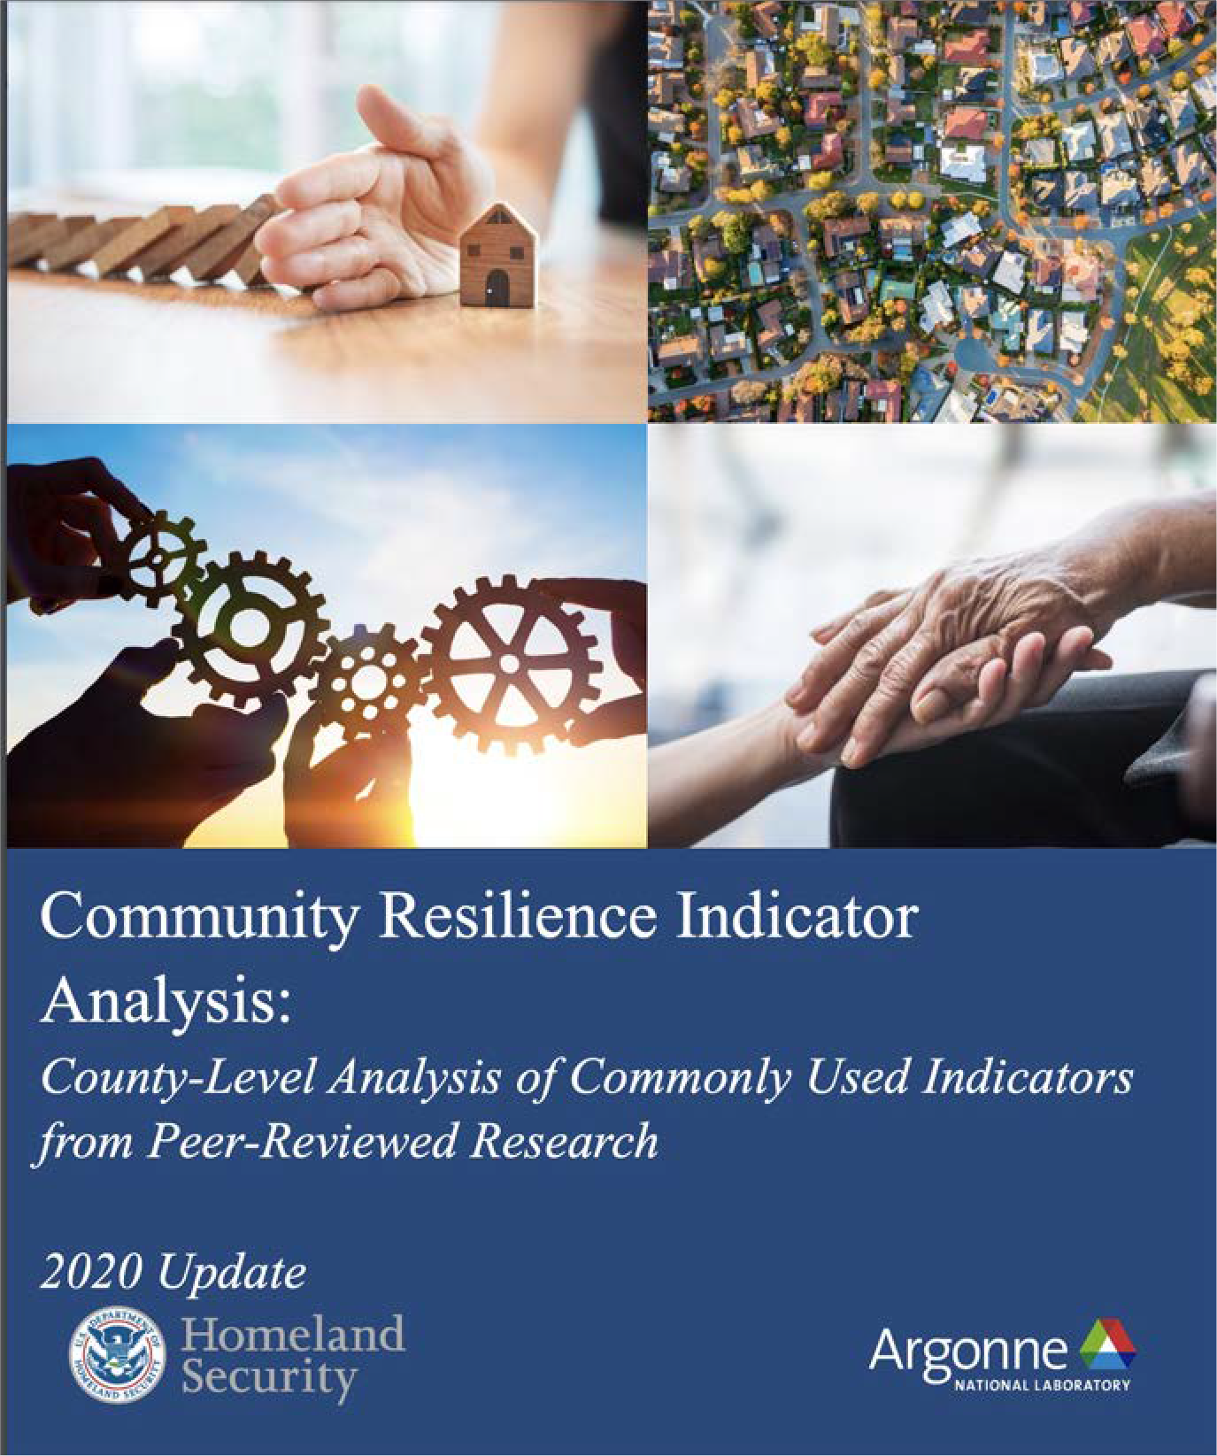
RQ3: Can community support SNF during emergencies?
County Resilience Indices
Using American Community Survey and local data to measure resiliency.
We summed the county level percentages for the Census variables:
Fraction Employed
Fraction with No Disability
Fraction with a High School Diploma or Greater
Fraction of Households with at least one vehicle, and
Reverse GINI Index – so all indicators are in positive direction
DATA SOURCE: ACS 2020 5-Year Estimates Detailed Tables (B18101, B19083, B23025, S0101, S1501)

Slide 31
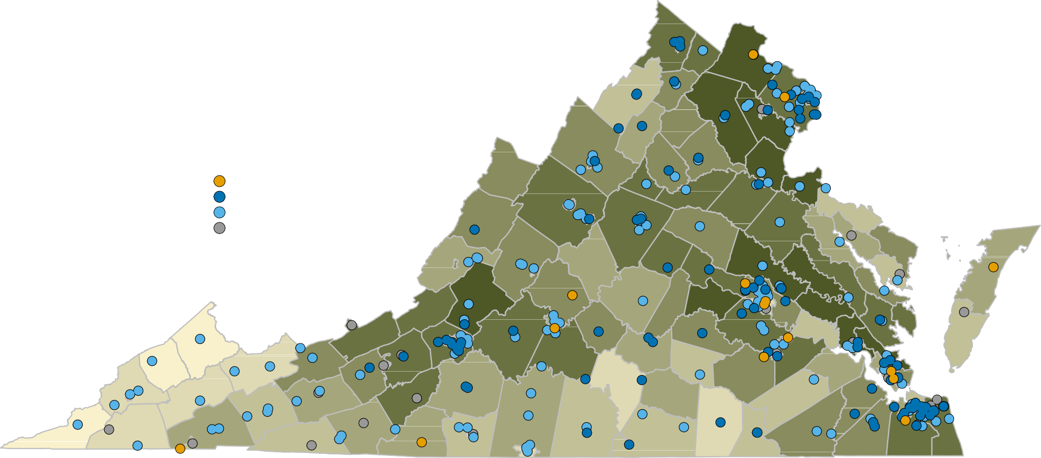
SNF Deficiency & County Resilience Indices
2020 Population Resiliance Composite Index by County
Fraction Employed, No Disability, High School Diploma or Greater, Households with at Least One Vehicle, and Reverse Gini Index
Skilled Nursing Facility Fire Safety & Emergency Preparedness Deficiency Index
Most Deficient
Least Deficient No Deficiencies
Population Resiliency Composite Index (0=Least Resilient, 1=Most Resilient)
0.762 0.786 0.810 0.827 0.841
ACS 2020 5−Year Estimates Detailed Tables (B18101, B19083, B23025, S0101, S1501)
Fire Safety Deficiencies and Inspection Dates (01/2018−03/2022): The Centers for Medicare & Medicaid Services
0.856
0.871
0.891

Slide 32
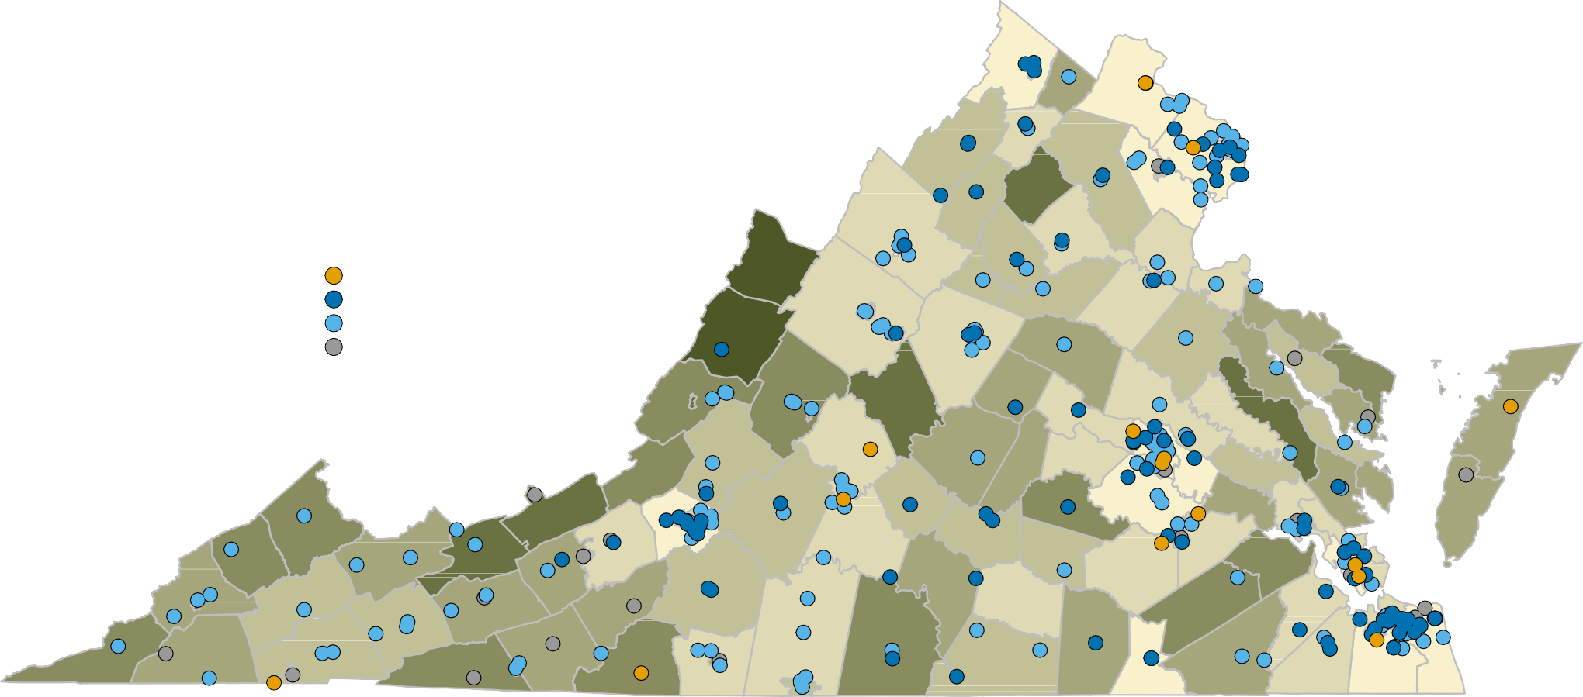
Virginia Emergency Facility Services & Shelters
Shelter Facilities and Emergency Service Providers by County and Independent City
Facilities and Services per 10,000 Residents
Skilled Nursing Facility Fire Safety & Emergency Preparedness Deficiency Index
Most Deficient
Least Deficient No Deficiencies
Number of Facilities & Services/10,000 Residents
1.27 3.65 6.39 9.03 12.3
Homeland Infrastructure Foundation−Level Data: https://hifld−geoplatform.opendata.arcgis.com/
Fire Safety Deficiencies and Inspection Dates (01/2018−03/2022): The Centers for Medicare & Medicaid Services
18.2 24.4
40.3

Slide 33
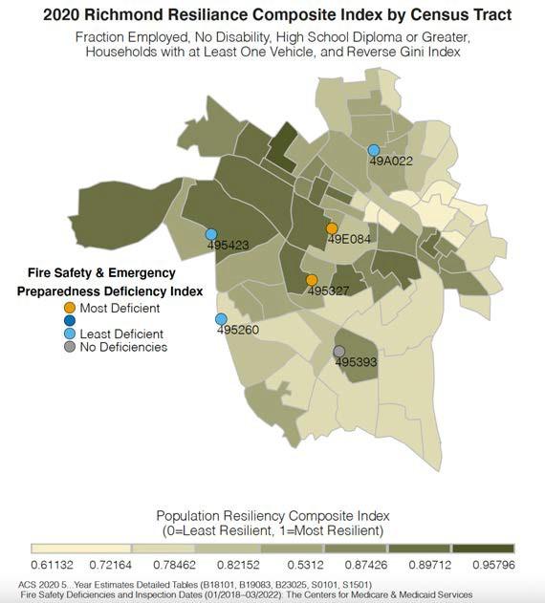
If we take a closer look, what can we learn?
At the SNF level, no facility changed ownership in the last year.
3 for-profit, 2 not-for-profit, and 1 government owner. Relatively high riverine flood risk and low coastal flood risk.
On average 18% of the SNF workers will not make it to work if an extreme flooding event occurs.
SNF 495327 had emergency preparedness deficiencies that were wide in scope but not immediate jeopardy; they failed to:
Conduct tests and exercises for requirements (EP);
Establish policies and procedures for sheltering (EP); and
Test and maintain the automatic sprinkler and fire alarm systems (LSC).
City of Richmond SNFs | 495260 | 495327 | 495393 | 495423 | 49A022 | 49E084
Maximum Riverine Flood Risk | 13.80 | 15.51 | 14.57 | 16.39 | 14.41 | 14.48
Maximum Coastal Flood Risk | 2.91 | 2.33 | 1.66 | 2.28 | 1.62 | 2.30
% Nursing Staff Loss if Flood Event | 18% | 20% | 17% | 21% | 15% | 17%
SNF Deficiency Index | Low | High | None | Low | Low | High

Slide 34
Data Ingestion and Governance - GitHub
Folders, sub-Folders, and sub-sub-Folders
Documents Source Code Data
Discovery Analyses
Literature | Products
Deficiencies | Data Tables**
Emergency Preparedness | Curation Report & Presentations
Nursing Staff Levels
Ownership | Visualizations
Quality | Processes**
Resilience
SNF*** | Community
Facility* | Demographic
Nursing Staff* | Climate Change Risk*
Residents* | Resilience*
Owners*
https://github.com/uva-bi-sdad/census_cde_demo_2/
*Each folder contains a meta data folder with data dictionaries and technical documents.
**Contains additional subfolders.
***SNF is Skilled Nursing Facilities

Slide 35


Use and Reuse of CDE Components
Resolve once, use many times
Data sources
Synthetic population estimates
SNF location and characteristics
Baseline community emergency preparedness assets
Functions
Creating transportation routes
Computing the probability of flood risks
Estimating SNF resiliency & community resilience
ART OF THE
POSSIBLE
Applications
Use cases inform CDE component development and reusability
Data Sources
Functions
Applications
Curation - Organize and document data to enable the discovery and reuse in research and data production
Wrangle & integrate many types and sources of data
Understand differences in similar measures

Slide 36
Discussion

